Slide 1



TVS EPIC 7.0
Analytics Submission
Case 2 : Loan Collection Tathagatha
Presented by Sanskar Ughade

Slide 2
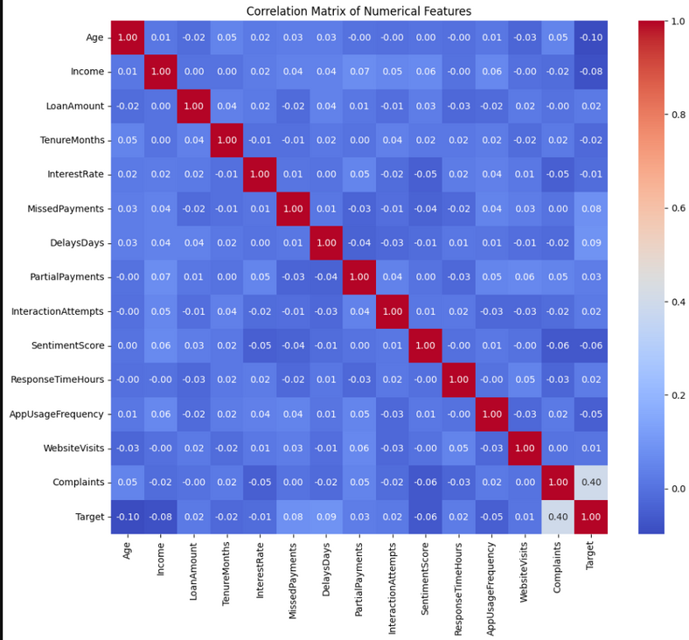
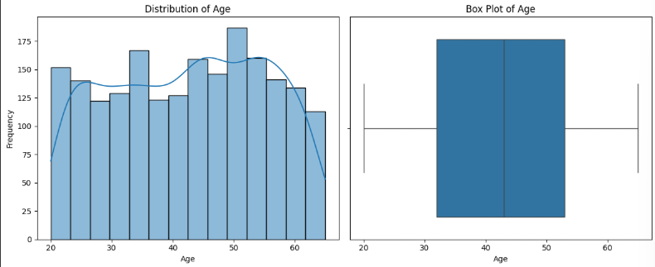

01
Analysis
Performed EDA (Exploratory Data Analysis) on the dataset -
Assessed dataset shape and identified NULL values.
Computed descriptive statistics (mean and other statistical quantities)
Visualised the distribution with histograms and box plots
Analysed the categorical distribution for each categorical feature.
Created a correlation matrix to examine relationships between features.
Examined the frequency of the target variable, its percentiles and their relationship with all features.
Compared the distribution of the target variable within each category.
Conclusion: The target is strongly influenced by complaints, delay days, and missed payments (positive correlation), while age and income show a strong negative correlation. These insights guide feature selection for predictive modeling.
Link: Colab

Slide 3
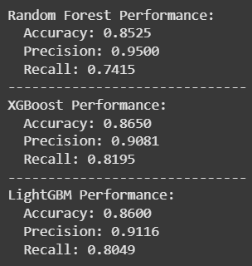
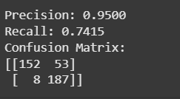
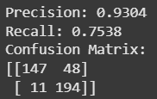
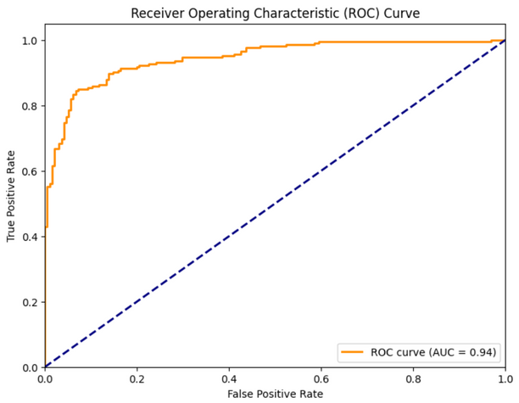

Prediction Modeling
Test set
Validation set
One-hot encoded categorical features into binary form.
Created new features (eg Debt-to-Income Ratio, Delinquency Rate)
Detected outliers with the IQR technique. Retained them to prevent dropping data. The chosen model could handle them.
Normalised the dataset using Min-Max Scaler (range - 0 to 1)
Split the data into training, validation and test sets.
Chose the Random Forest model and performed hyperparameter tuning using 5-fold cross-validation with GridSearchCV.
Trained on full training set with optimal parameters.
Assessed the model performance on the validation and test sets.
Evaluated on validation and test sets using accuracy, precision, recall and ROC-AUC.
Benchmarked against XGBoost and LightGBM.
Fine-tuned tree threshold to improve metrics.
Enhanced interpretability with SHAP values and dependence plots
The evaluation criteria is chosen due to the following Business Goals
Evaluation Metric
Correctly identify actual defaulters as Default (True Positives)
Minimise cases where defaulters are predicted as Not Default (False Negatives), the riskiest scenario for the firm
Prioritise high precision and low False Negatives in the confusion matrix
1. High precision
2. Low FN’s
02

Slide 4

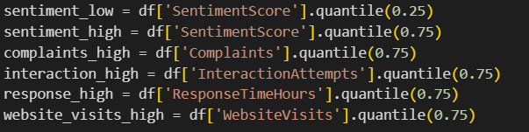
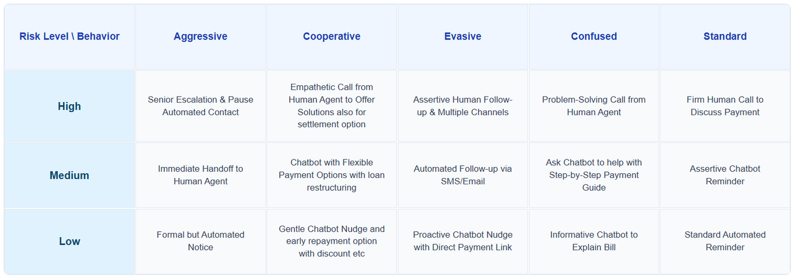
Note
03
Recommendation Engine
Problem Encountered - Hardcoded the comparison thresholds, but the thresholds would only work on this dataset and not on any other dataset if there were variations in ranges.
Solution - Shifted to percentile-based thresholds for features with a lower bound and upper bound percentile values. This made the thresholds dynamic, which adjusted to the dataset, leading to more robust recommendations.
Future Improvement - In the future, the model can be trained to predict these thresholds automatically.
Assigned a risk score to each customer based on the predictive model.
Built a rule-based engine to generate personalised recommendations
Classified customers into three categories, based on risk scores
Low Risk
Mid Risk
High Risk
Defined personas to customers based on interaction history, complaints and other engagement signals
Designed a matrix to map strategies for each risk persona combination
Dynamic Thresholds
Strategy Matrix
Ran a script to generate sub-datasets based on customer behaviour and persona (e.g., aggressive customers, silent churners, loyal advocates etc.)
Recommendations were designed to leverage the chatbot for friendly and empathetic engagement with low-risk, cooperative customers, while escalating to human intervention as risk levels and customer aggression increases.

Slide 5

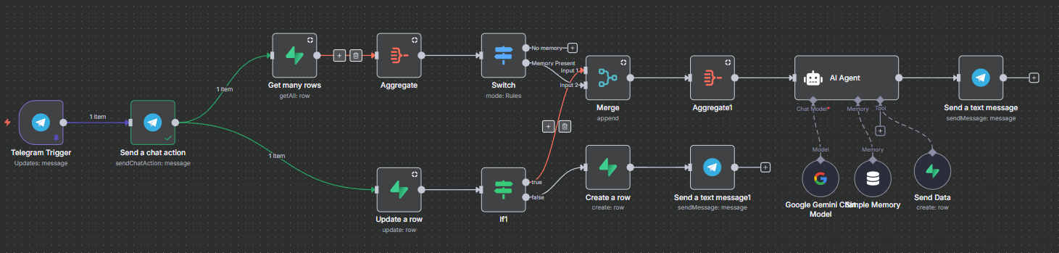



04
ChatBot
Bot Link
Features & USP
Name of the bot : TVS Sahahyak
Goal: To build a production-ready NBFC support chatbot that remembers users and fetches their financial data.
Platform of Choice: Started with WhatsApp, switched to Telegram for faster setup.
Tech Stack: n8n (workflow automation) + Supabase (database).
Context Aware Responses - Remembers past conversations to provide relevant answers without repeating questions.
Direct Financial Data Access - Instantly fetches customer information for faster resolution.
Personalised Assistance - Tailors replies based on user profile and past interactions.
Seamless Onboarding - Automatically identifies and saves new users without manual data entry.
Robust Identification System - Uses unique chat ID for accurate, consistent user recognition.
Multi Case Handling - Adapts to users with or without stored data and keeps workflow smooth.
Optimized Workflow - Built to eliminate duplicate responses and handle edge cases efficiently.
Detailed Description
Database Design:
Customer Data → stores financial details.
Conversation Memories → remembers chat history & key user info.
Tech-Stack:
+
+
n8n
Automation tool
Supabase
for Database
Telegram for
Chat integration
n8n workflow

Slide 6
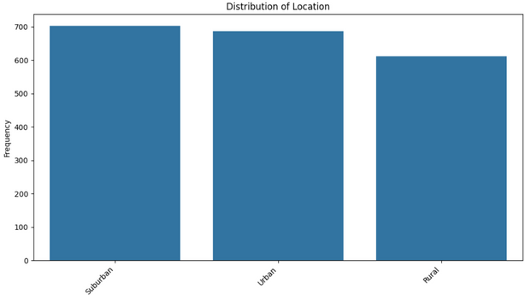
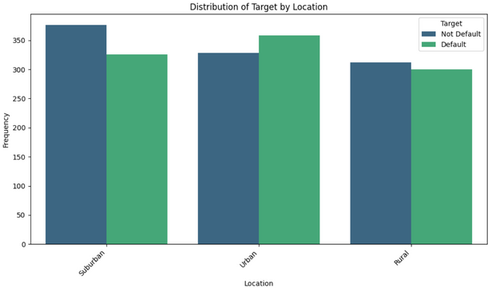
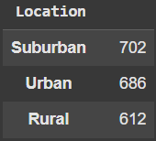
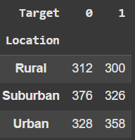
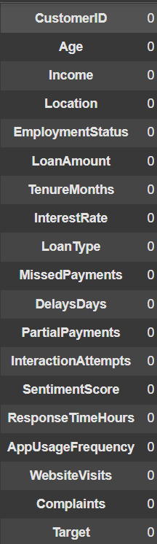
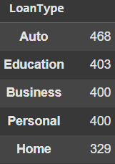
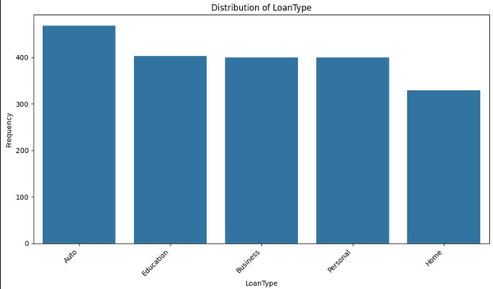
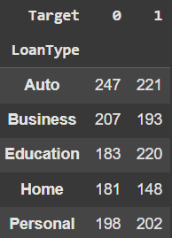
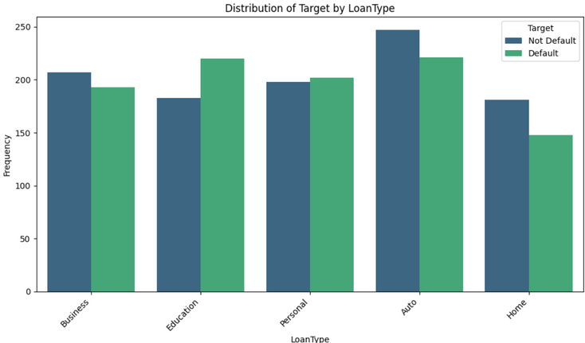
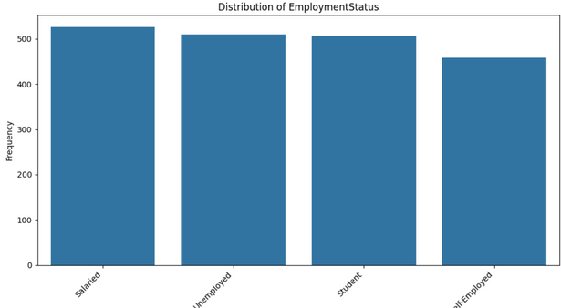
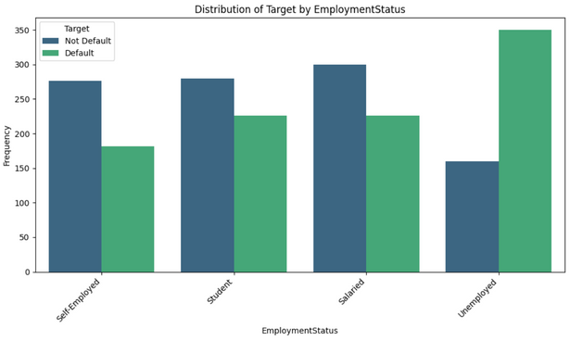
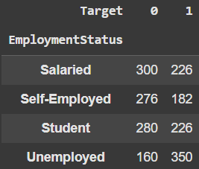
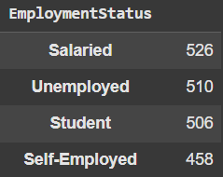
Appendix - I
Analysis Category Distributions
Shape of Dataset
(2000, 19)
Missing Values
No Null Values

Slide 7
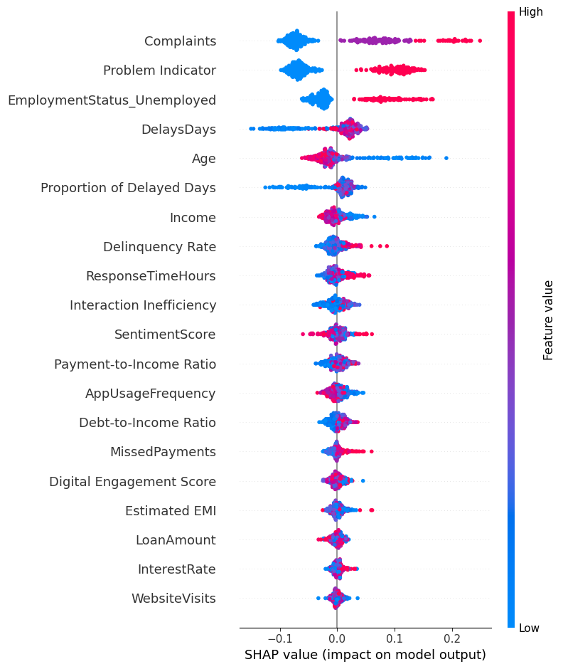
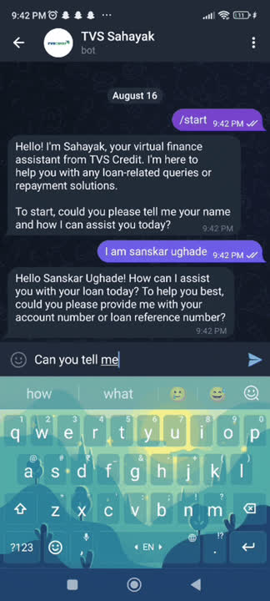
Appendix - II
SHAP Values
Chatbot video :- click to play
Links
Analysis Notebook Collab | Drive
Prediction Model Notebook Collab | Drive
Recommendation Model Notebook Collab | Drive
Chatbot (Sahayak) n8n workflow Drive
Description of Building the Chatbot Doc
Prediction with risk scores Link
Ideations Link
Recommmendation Strategy Output Link

Slide 8
Thank You
Presented by Sanskar Ughade

